Slide 1
Classical Search
Chapter covers techniques (some developed outside of AI) that don’t try to cover the whole space and only the goal state, not the steps, are important.
The techniques tend to use much less memory and are not guaranteed to find an optimal solution.

Slide 2
More Search Methods
Local Search
  Hill Climbing
  Simulated Annealing
  Beam Search
  Genetic Search
Local Search in Continuous Spaces
Searching with Nondeterministic Actions
Online Search (agent is executing actions)

Slide 3
Local Search Algorithms and Optimization Problems
Complete state formulation
  For example, for the 8 queens problem, all 8 queens are on the board and need to be moved around to get to a goal state
Equivalent to optimization problems often found in science and engineering
Start somewhere and try to get to the solution from there
Local search around the current state to decide where to go next

Slide 4
Pose Estimation Example
Given a geometric model of a 3D object and a 2D image of the object.
Determine the position and orientation of the object wrt the camera that snapped the image.
image 3D object
State (x, y, z, x-angle, y-angle, z-angle)

Slide 5
Hill Climbing
“Gradient ascent”
solution
Note: solutions shown
here as max not min.
Often used for numerical optimization problems.
How does it work?

Slide 6
AI Hill Climbing
Steepest-Ascent Hill Climbing
current ← start node
loop do
  neighbor ← a highest-valued successor of current
  if neighbor.Value <= current.Value then return current.State
  current ← neighbor
end loop

Slide 7
Hill Climbing Search
current
6
4
10
3
2
8
What if current had a value of 12?

Slide 8
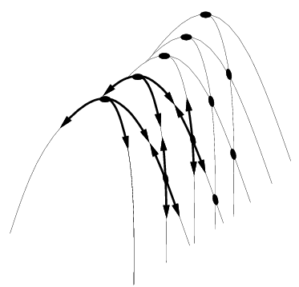
Hill Climbing Problems
  Local maxima
  Plateaus
  Diagonal ridges
What is it sensitive to?
Does it have any advantages?

Slide 9
Solving the Problems
Allow backtracking (What happens to complexity?)
Stochastic hill climbing: choose at random from uphill moves, using steepness for a probability
Random restarts: “If at first you don’t succeed, try, try again.”
Several moves in each of several directions, then test
Jump to a different part of the search space

Slide 10
Simulated Annealing
Variant of hill climbing (so up is good)
Tries to explore enough of the search space early on, so that the final solution is less sensitive to the start state
May make some downhill moves before finding a good way to move uphill.

Slide 11
Simulated Annealing
Comes from the physical process of annealing in which substances are raised to high energy levels (melted) and then cooled to solid state.
The probability of moving to a higher energy state, instead of lower is
p = e^(-ΔE/kT)
where ΔE is the positive change in energy level, T is the temperature, and k is Bolzmann’s constant.
heat cool

Slide 12
Simulated Annealing
At the beginning, the temperature is high.
As the temperature becomes lower
  kT becomes lower
  ΔE/kT gets bigger
  (-ΔE/kT) gets smaller
  e^(-ΔE/kT) gets smaller
As the process continues, the probability of a downhill move gets smaller and smaller.

Slide 13
For Simulated Annealing
ΔE represents the change in the value of the objective function.
Since the physical relationships no longer apply, drop k. So p = e^(-ΔE/T)
We need an annealing schedule, which is a sequence of values of T: T₀, T₁, T₂, ...

Slide 14
Simulated Annealing Algorithm
current ← start node;
for each T on the schedule /* need a schedule */
  next ← randomly selected successor of current
  evaluate next; it it’s a goal, return it
  ΔE ← next.Value – current.Value /* already negated */
  if ΔE > 0
    then current ← next /* better than current */
    else current ← next with probability e^(ΔE/T)
How would you do this probabilistic selection?

Slide 15
Probabilistic Selection
Select next with probability p
Generate a random number
If it’s <= p, select next
p
0 1
random
number

Slide 16
Simulated Annealing Properties
At a fixed “temperature” T, state occupation probability reaches the Boltzman distribution
If T is decreased slowly enough (very slowly), the procedure will reach the best state.
Slowly enough has proven too slow for some researchers who have developed alternate schedules.
p(x) = αe^(E(x)/kT)

Slide 17
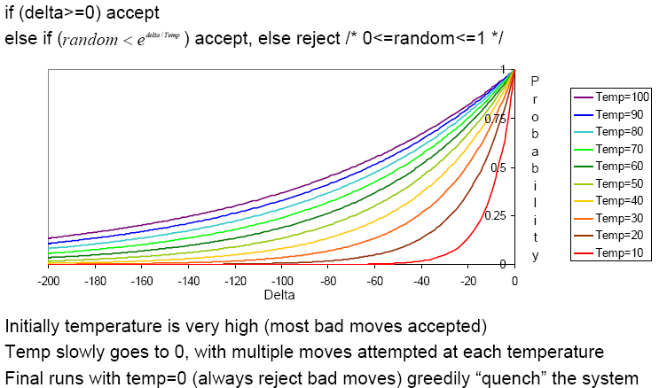
Simulated Annealing Schedules
Acceptance criterion and cooling schedule

Slide 18
Simulated Annealing Applications
Basic Problems
  Traveling salesman
  Graph partitioning
  Matching problems
  Graph coloring
  Scheduling
Engineering
  VLSI design
    Placement
    Routing
    Array logic minimization
    Layout
  Facilities layout
  Image processing
  Code design in information theory

Slide 19
Local Beam Search
Keeps more previous states in memory
  Simulated annealing just kept one previous state in memory.
  This search keeps k states in memory.
    - randomly generate k initial states
    - if any state is a goal, terminate
    - else, generate all successors and select best k
    - repeat
Pros? Cons?

Slide 20
Genetic Algorithms
Start with random population of states
  Representation serialized (ie. strings of characters or bits)
  States are ranked with “fitness function”
Produce new generation
  Select random pair(s) using probability:
    probability ~ fitness
  Randomly choose “crossover point”
    Offspring mix halves
  Randomly mutate bits
Crossover Mutation
174629844710
174611094281
164611094281
→
→
776511094281
776529844710
776029844210

Slide 21
Genetic Algorithm
Given: population P and fitness-function f
repeat
  newP ← empty set
  for i = 1 to size(P)
    x ← RandomSelection(P,f)
    y ← RandomSelection(P,f)
    child ← Reproduce(x,y)
    if (small random probability) then child ← Mutate(child)
    add child to newP
  P ← newP
until some individual is fit enough or enough time has elapsed
return the best individual in P according to f

Slide 22
Using Genetic Algorithms
2 important aspects to using them
  1. How to encode your real-life problem
  2. Choice of fitness function
Research Example
  We want to generate a new operator for finding interesting points on images
  The operator will be some function of a set of values v₁, v₂, … v_{K}.
  Idea: weighted sums, weighted mins, weighted maxs. a₁,…a_{K},b₁,…b_{K},c₁,…c_{k}

Slide 23
Local Search in Continuous Spaces
Given a continuous state space
S = {(x₁,x₂,…,x_{N}) | x_{i} ε R}
Given a continuous objective function f(x₁,x₂,…,x_{N})
The gradient of the objective function is a vector ∇f = (∂f/∂x₁,∂f/∂x₂,…,∂f/∂x_{N})
The gradient gives the magnitude and direction of the steepest slope at a point.

Slide 24
Local Search in Continuous Spaces
To find a maximum, the basic idea is to set ∇f =0
Then updating of the current state becomes
x ← x + α∇f(x)
where α is a small constant.
Theory behind this is taught in numerical methods classes.
Your book suggests the Newton-Raphson method. Luckily there are packages…..

Slide 25
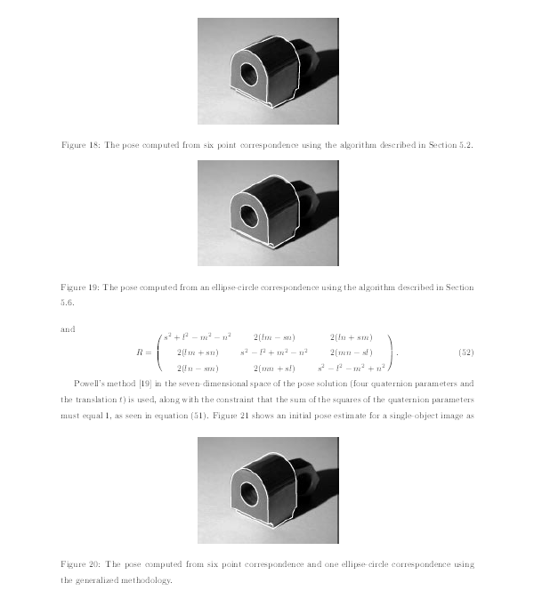
Computer Vision Pose Estimation Example

Slide 26
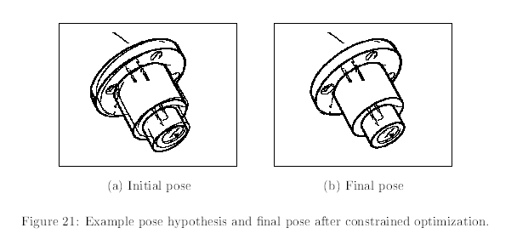
Computer Vision Pose Estimation Example
Read the “Airports in Romania” example in the text.

Slide 27
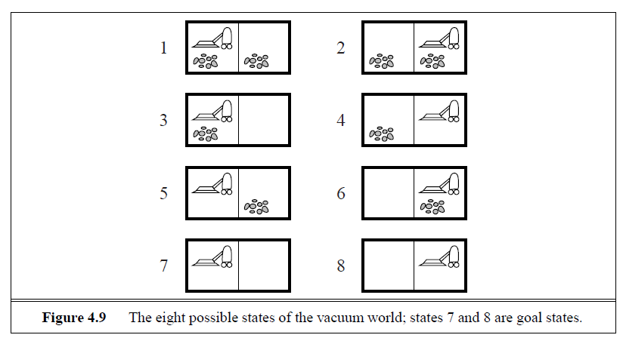
Searching with Nondeterministic Actions
Vacuum World (actions = {left, right, suck})

Slide 28
Searching with Nondeterministic Actions
In the nondeterministic case, the result of an action can vary.
  Erratic Vacuum World:
    When sucking a dirty square, it cleans it and sometimes cleans up dirt in an adjacent square.
    When sucking a clean square, it sometimes deposits dirt on the carpet.

Slide 29
Generalization of State-Space Model
Generalize the transition function to return a set of possible outcomes.
oldf: S x A -> S newf: S x A -> 2^{S}
2. Generalize the solution to a contingency plan.
if state=s then action-set-1 else action-set-2
3. Generalize the search tree to an AND-OR tree.

Slide 30
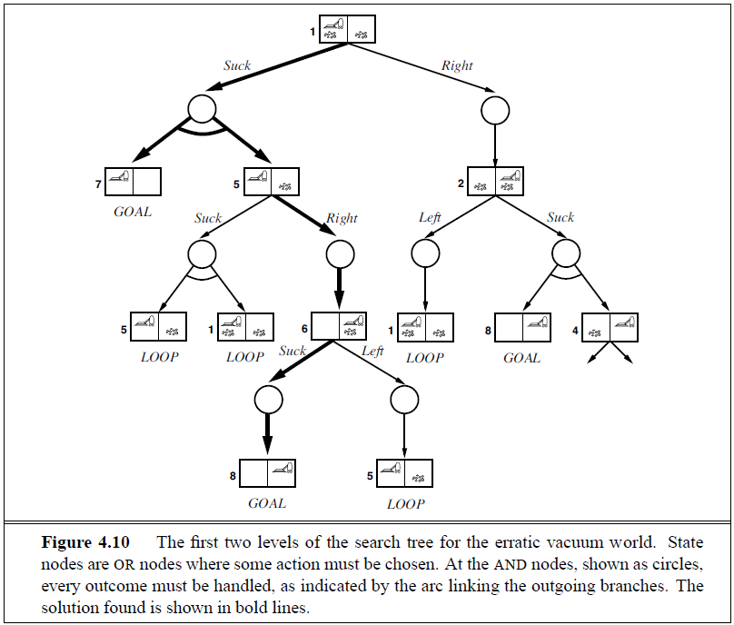
AND-OR Search Tree
OR
Node
AND
Node

Slide 31
Searching with Partial Observations
The agent does not always know its state!
Instead, it maintains a belief state: a set of possible states it might be in.
Example: a robot can be used to build a map of a hostile environment. It will have sensors that allow it to “see” the world.

Slide 32
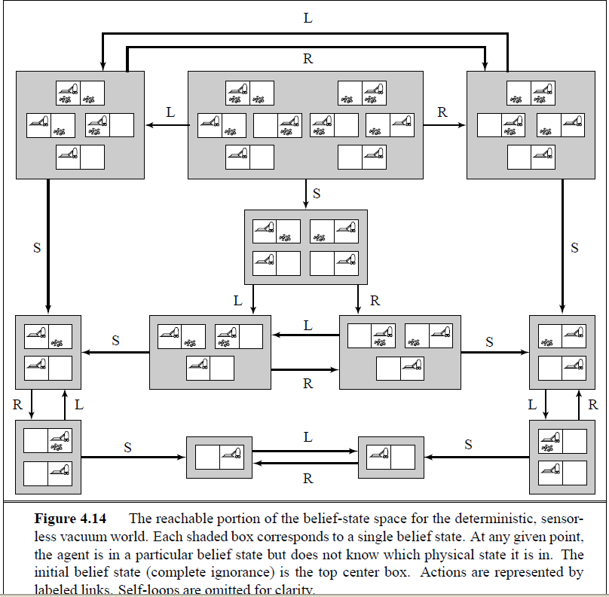
Belief State Space for Sensorless Agent
initial state
Knows it’s
on the left
Knows it’s
on the right.
Knows left
side clean

Slide 33
Online Search Problems
Active agent
  executes actions
  acquires percepts from sensors
  deterministic and fully observable
  has to perform an action to know the outcome
Examples
  Web search
  Autonomous vehicle

